Slide 1


Analysis of SLC Surgical Services Data
June - November 2017
- Saumik Tiwary

Slide 2
Data Description
Rows: 6328
Columns: 6
File Format: Microsoft Excel Worksheet
Column Name | Type | Sample Values
SERVICE AREA | String | SLC SURGICAL SERVICES
PROVIDER_TYPE | String | PHYSICIAN ; NON – PHYSICIAN PRACTITIONER
POST_PERIOD | String | 2017/11; 2017/10; 2017/09; 2017/08; 2017/07; 2017/06
PROCEDURE_ID | String | 2; 3; 6060; 3006; 124330
CHARGES | Number | 59.88; 80.284; 12926.58
PAYMENT | Number | 59.88; 80.284; 12926.58

Slide 3
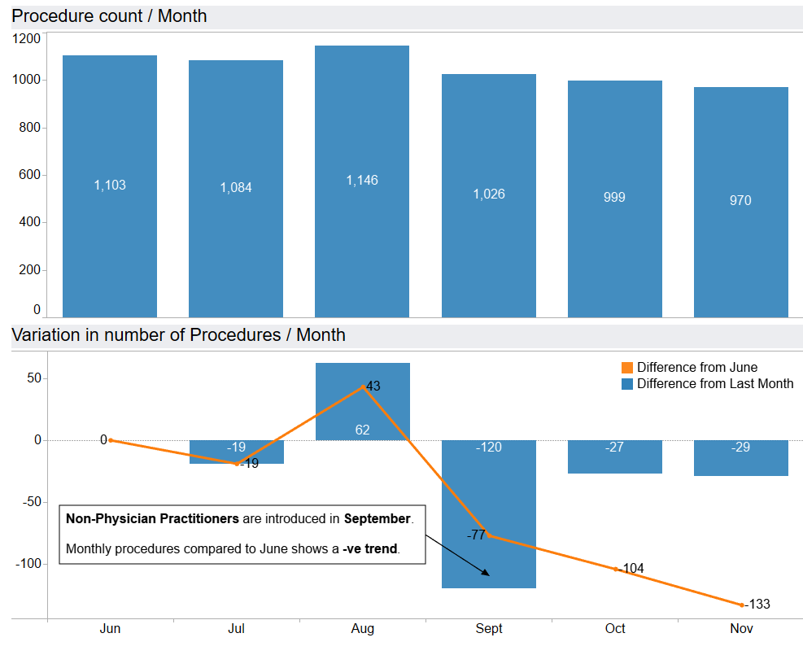
Trend Analysis
Number of procedures operated on decreased in July but reached highest in August and went on a downward trend after that.
July had a minor decrease but was compensated by a relatively high bump in August.
September saw biggest decline and introduced a downward trend to reach the lowest in November.

Slide 4
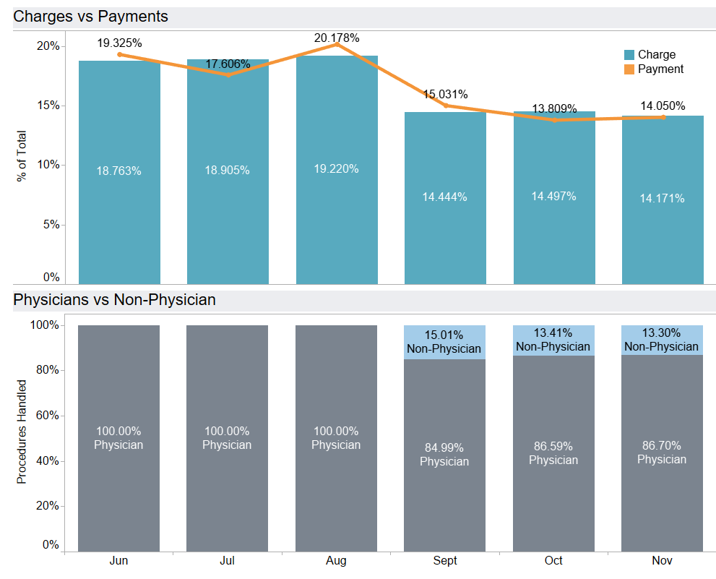
Trend Analysis
August and June contributed highest in terms of Payments with more than 40%
Payments have varied more from June to September
Charges showed less variance when seen in groups (Jun, Jul, Aug), (Sept, Oct, Nov)
First 3 months have only Physicians
Percentage of Physicians slowly increases again after getting reduced by introduction of Non-Physician Practitioners in September

Slide 5
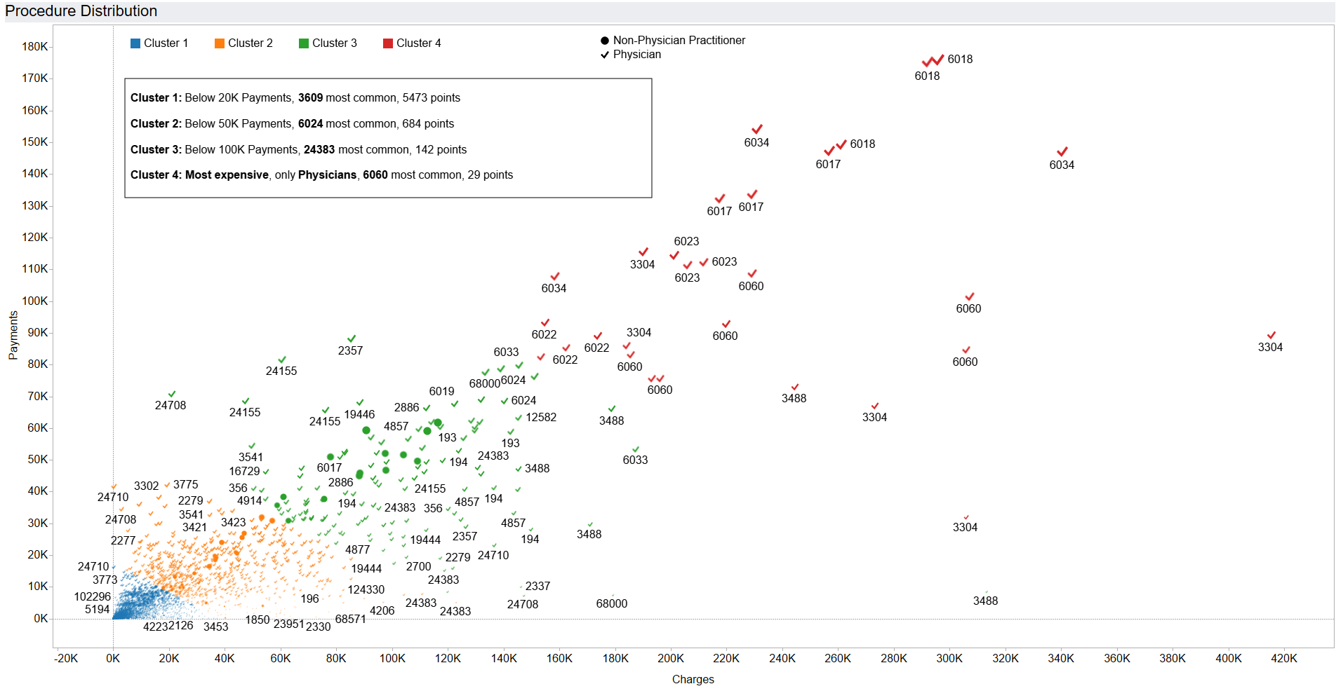
Data Distribution

Slide 6
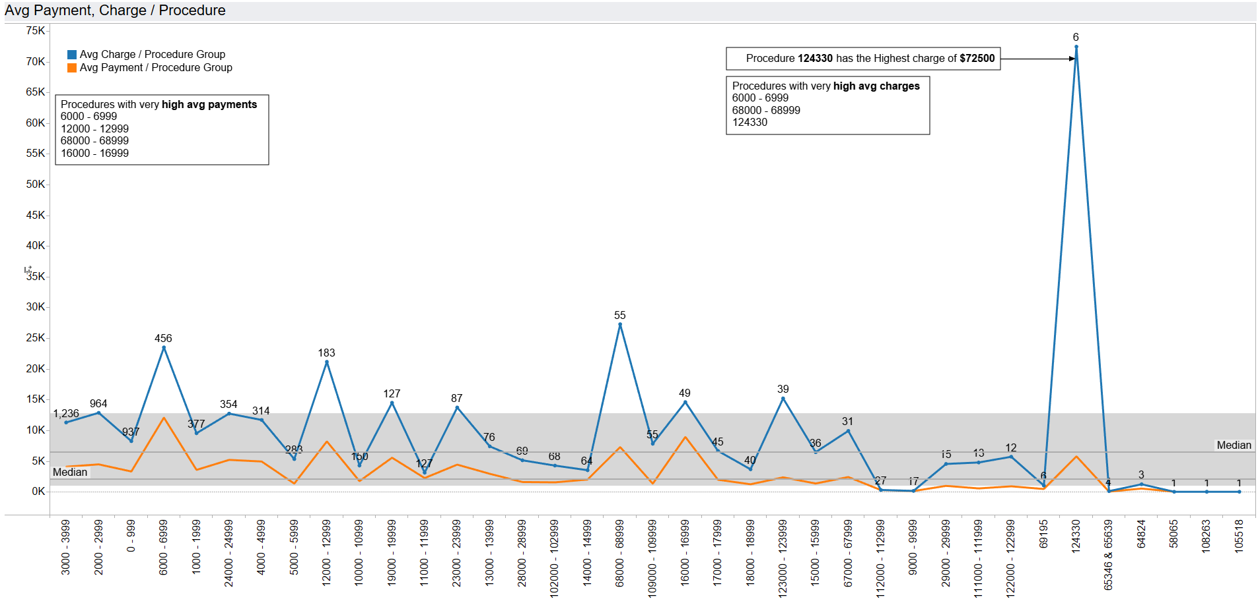
Anomaly | Outlier

Slide 7
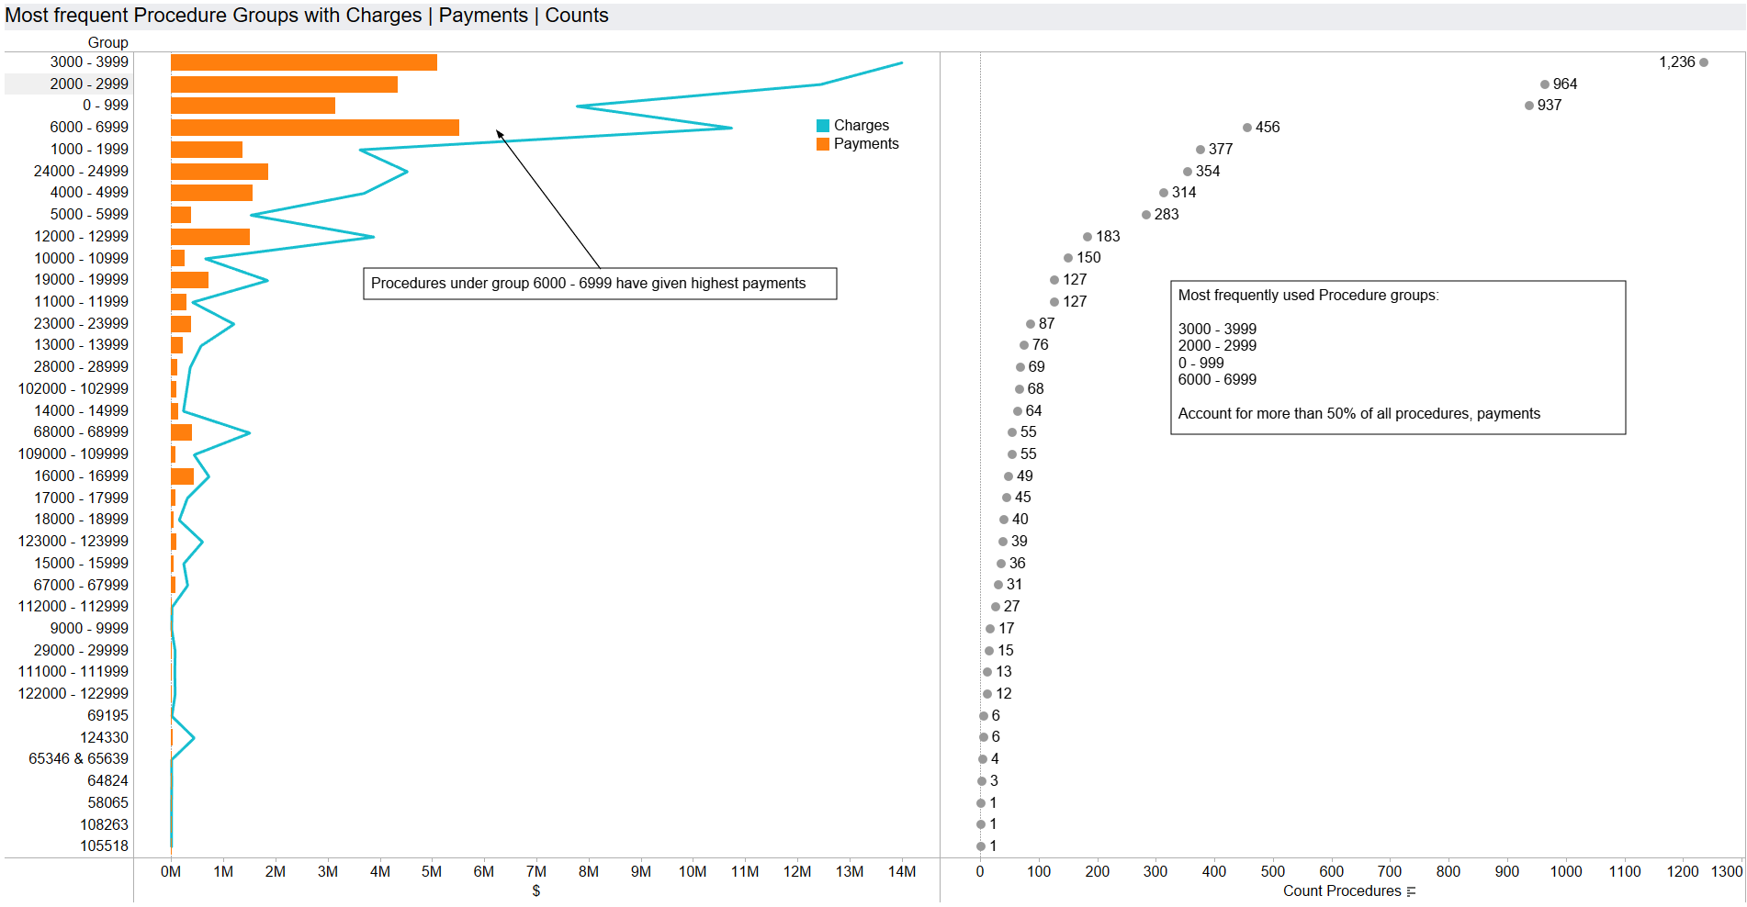
Unique Cases

Slide 8
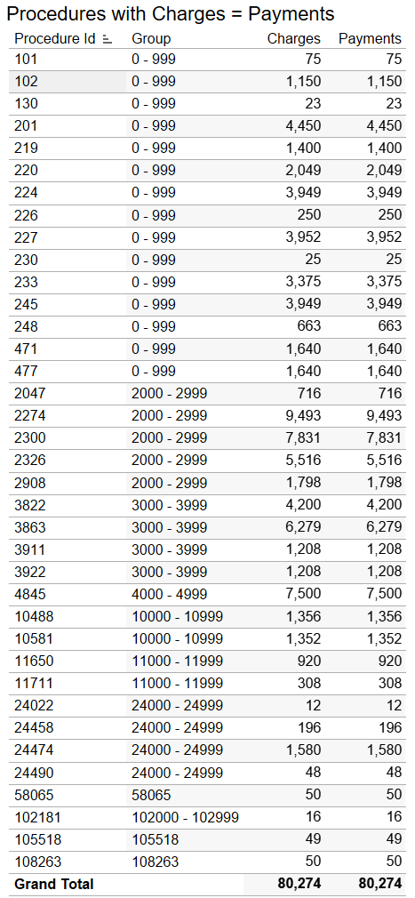
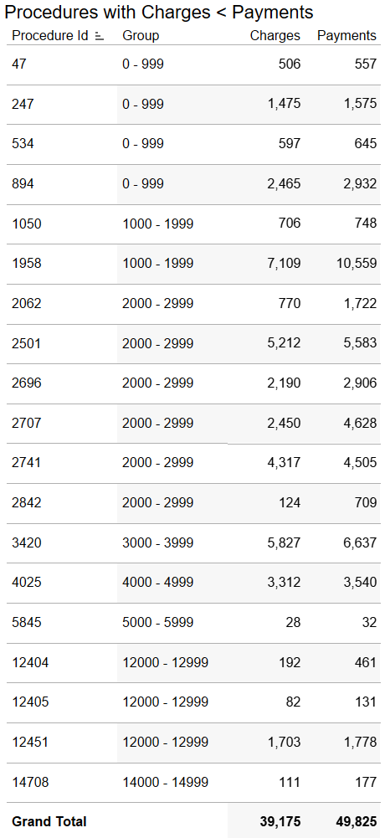
Unique Cases
There were 37 cases where the charges were same as Payments
There were 19 cases where the Payments were more than the Charges

Slide 9
Conclusion
The data shows a trend related to decrease in payments when Non-Physician Practitioners are included, and payment related to Non-Physician Practitioners is less by high margin as compared to Physicians
There are certain cases where the Payments are equal or more than the charges
Certain groups of procedures are very costly. Procedures 3304, 3488, 6060, 24383 were done only by Physicians and were over a million dollars in cost considering the whole 6 month timeframe
Some group of procedures were most common and comprised for more than 50% of total procedures for 6 months

Slide 10
Thank You
Notes:
You can use this slide as your opening or closing slide. Should you choose to use it as a closing, make sure you review the main points of your presentation. One creative way to do that is by adding animations to the various graphics on a slide. This slide has 4 different graphics, and, when you view the slideshow, you will see that you can click to reveal the next graphic. Similarly, as you review the main topics in your presentation, you may want each point to show up when you are addressing that topic.
Add animation to images and graphics:
Select your image or graphic.
Click on the Animations tab.
Choose from the options. The animation for this slide is “Split”. The drop-down menu in the Animation section gives even more animations you can use.
If you have multiple graphics or images, you will see a number appear next to it that notes the order of the animations.
Note: You will want to choose the animations carefully. You do not want to make your audience dizzy from your presentation.

